Slide 1

Geosteering Using True Stratigraphic Thickness
Charles R. Berg, ResDip Systems, and Andrew C. Newson, Moose Oils, Inc.

Slide 2
Topics Covered
What is True Stratigraphic Thickness (TST)?
TST logs and forward modeling, pilot versus template
Calculating the forward model
Positioning the log trace
Relative sample rate
Handling faults
Cross section display types
Vertical sections
Curtain sections
Vector sections
Applications of structural modeling
Fault modeling using existing dips
Simultaneous fault and dip modeling (as in
geosteering).

Slide 3
3D TST Configuration
Borehole
Top of Bed
Base of Bed
TST Vector
Notes:
TST as a 3D vector

Slide 4
2D TST Configuration
This cross section is in the plane in which the borehole and
bed-normal lie. (The plane is not necessarily vertical)
Borehole
MT
Top of Bed
TST
Base of Bed
Notes:
TST as a vector
MT is projected onto the pole to dip

Slide 5
TST Equation
The standard form:
Modified from Tearpock and Bischke, 1991
The vectoral form:
Where TST = true stratigraphic thickness
MT = measured thickness
φ = dip
θ_{d} = the dip azimuth
ψ = borehole inclination
θ_{b} = borehole azimuth
    = lower-hemisphere dip-pole direction
= borehole direction
Notes:
Represents vector length. Sometimes called the Setchell equation.

Slide 6
2D TST Configuration Up Section
TST vector points same direction as borehole. The calculated
TST will have a negative sign, and the borehole will traverse
from the base to the top of the unit.
Borehole
MT
TST
Top of Bed
Base of Bed
Notes:
TST as a vector

Slide 7
Modeling by Stretching the Template Log
The template log (or pilot) needs to be stretched in order
to account for the added thickness.

Slide 8
Vertical Wells as Templates
If there is significant dip, a vertical well (or pilot) needs to be
converted to TST to be a proper template.
Notes:
Borehole log reversed for clarity

Slide 9
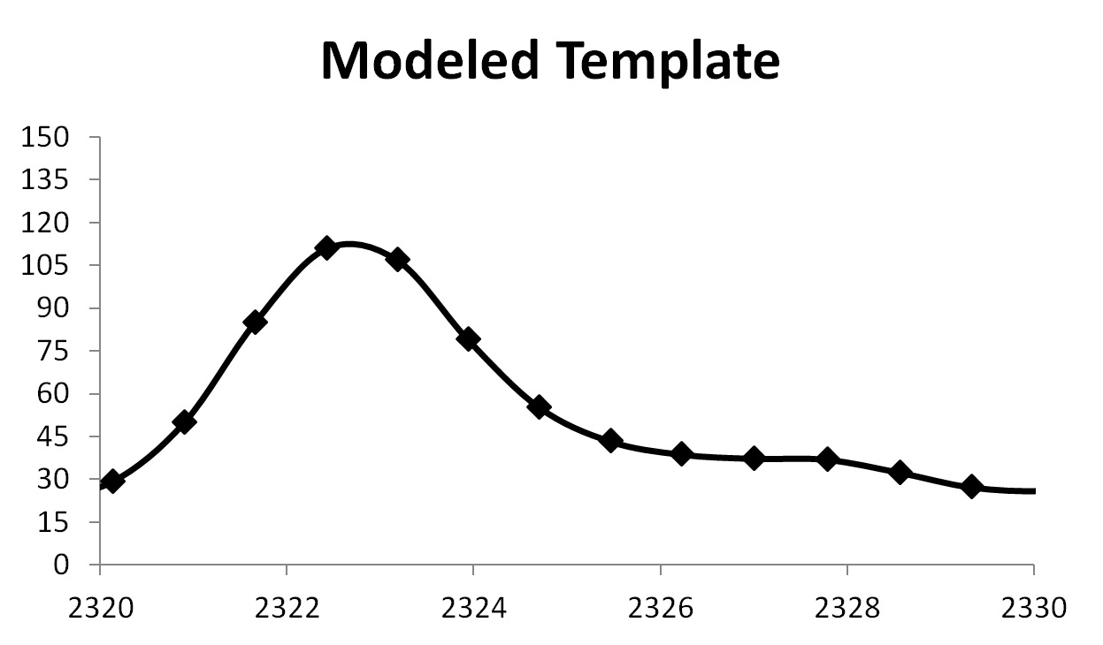
Making the Template Fit the Log
Common
Top
Notes:
TST in the well is cumulative and starting at an arbitrary point.
A common top is found, and then the template points are shifted to match the TST in the well.

Slide 10
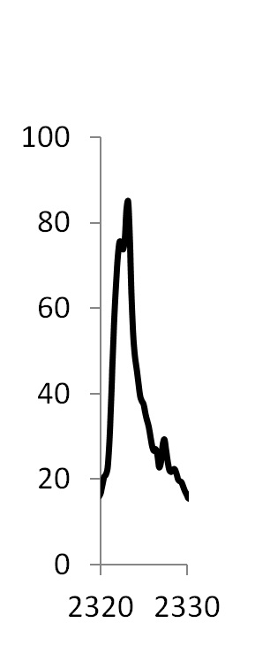
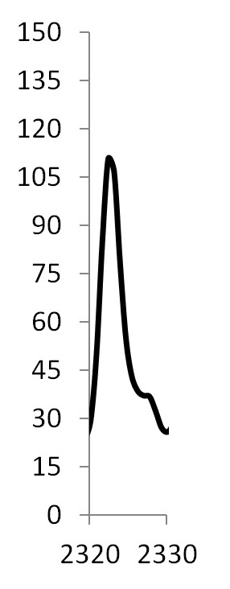
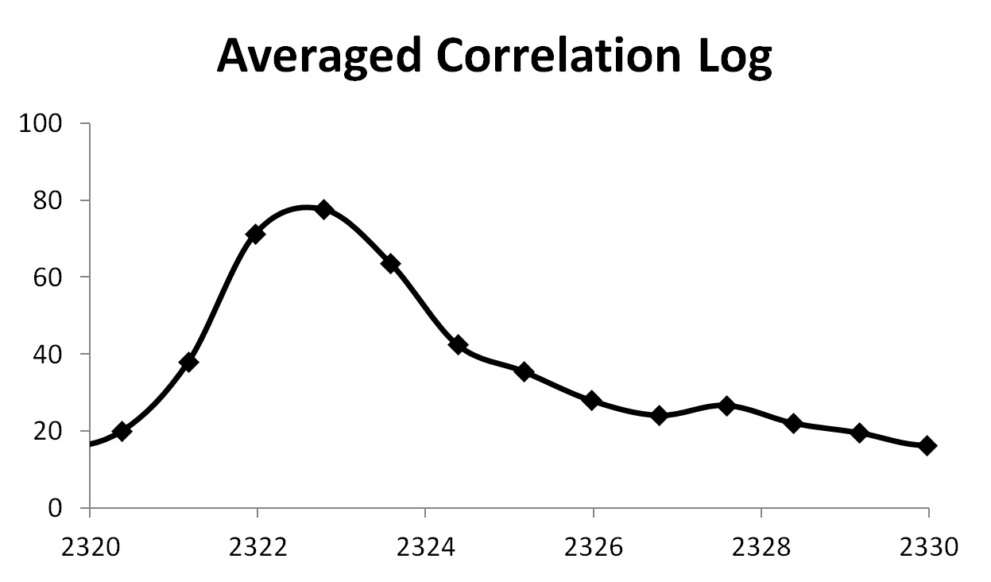
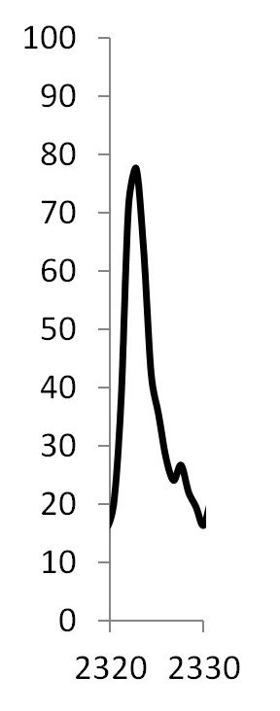
Relative Sample Rate
Notes:
The effective ample rate in template is about 4x the well. This relates to about 15 degrees dip.

Slide 11
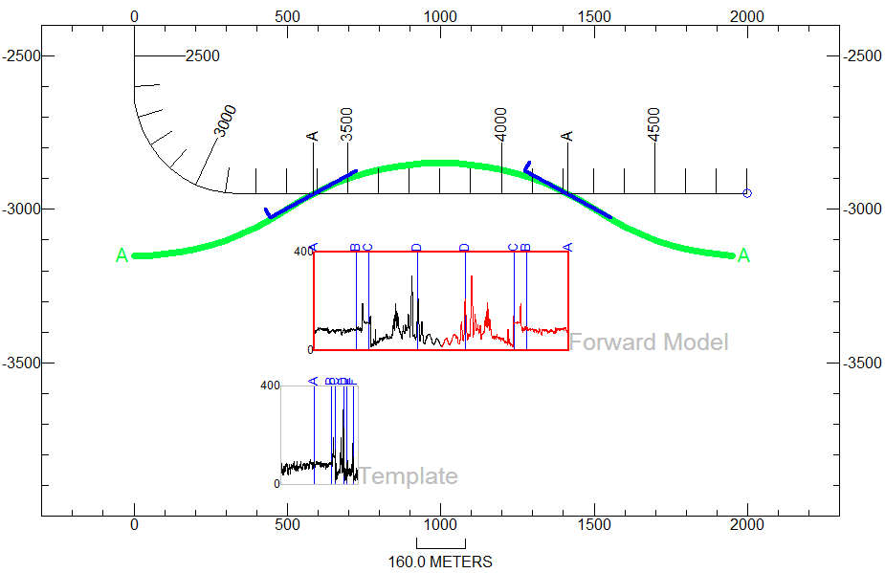
Anticline Forward Model
The green horizon is a gridded model of a cylindrical fold.
The log pattern generated is called “reflection” or “mirroring”.
Model
Template
Notes:
Template shown true scale
Dip and deviation are interpolated at 50m intervals.

Slide 12
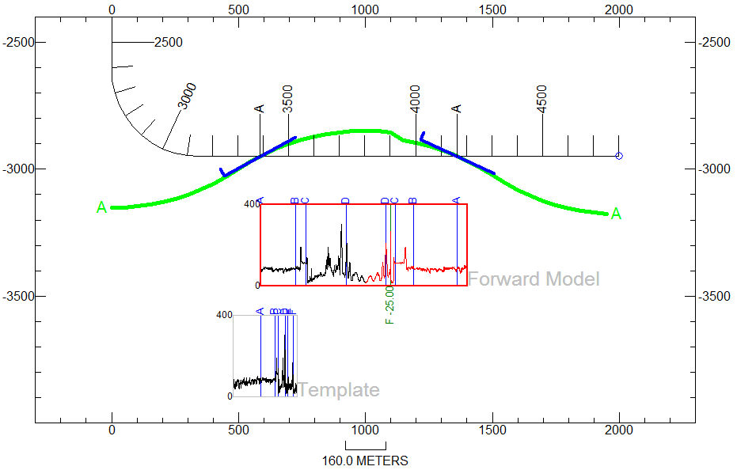
Faulted Model
The fault is at 3900m.
The missing section of 25m is subtracted from TST values.
Fault
Fault
Model
Template

Slide 13
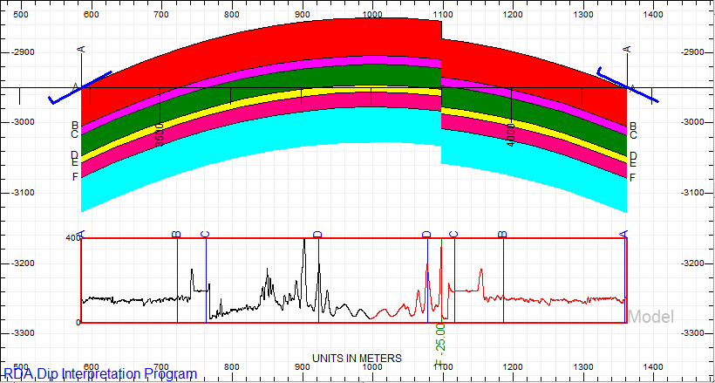
Faulted Model with all Horizons

Slide 14
Map for Standard Section Types
Departure and displacement on a borehole survey.
These two variables are used to create vertical sections
and curtain sections, respectively.
Borehole (and Curtain Section)
Bottom-Hole
Location
Displacement
Vertical Section
Surface
Location
Departure

Slide 15
Horizon Placement
Horizons are calculated by finding the stratigraphic position at a point and then extrapolating vertically above and
below to the respective stratigraphic horizons.
A
Borehole
B
A
C
B
D
C
D

Slide 16
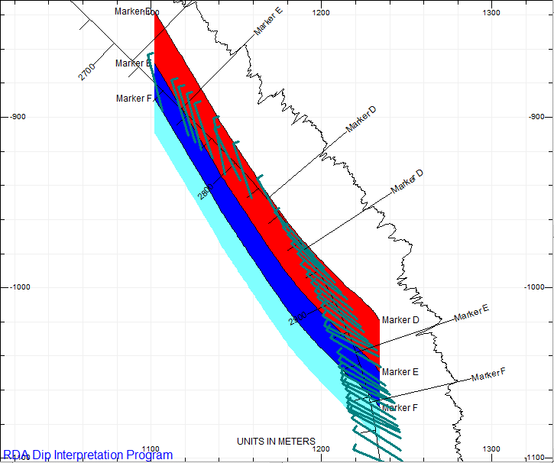
Curtain Section

Slide 17
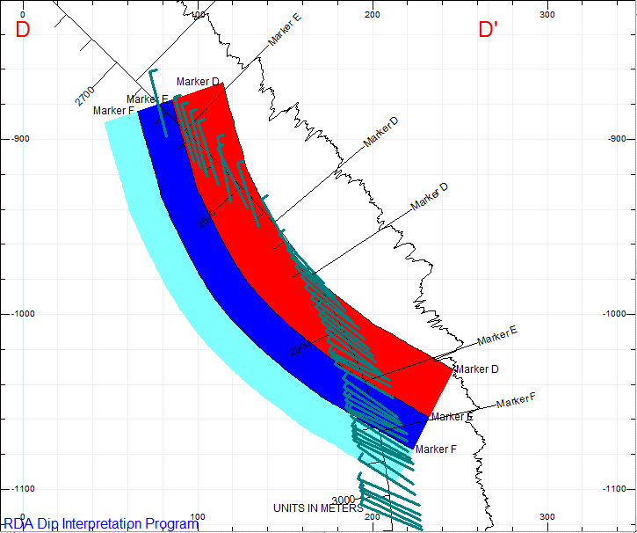
Vector Section
Notes:
Assumes cylindrical folding

Slide 18
Sample Rates Affect Interpretation
Standard Scale
Compressed Scale
Isolated from Above
Left Half Flipped and Stretched
Notes:
The same two peaks are circled on the standard and compressed scales.
Standard scale is about 1:2400 and compressed is about 1:24000.

Slide 19
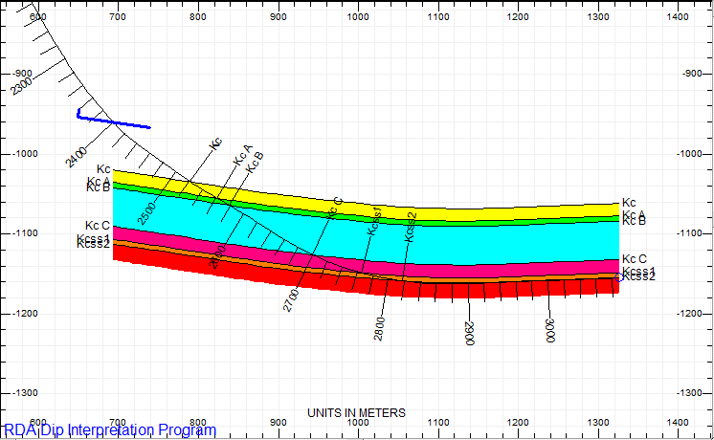
Single Dip on a Curtain Section
Borehole
Map

Slide 20
TST Predicts Change in Apparent Dip
Map

Slide 21
Vertical Section with Gridded Data
Vertical Section Profile
Map

Slide 22
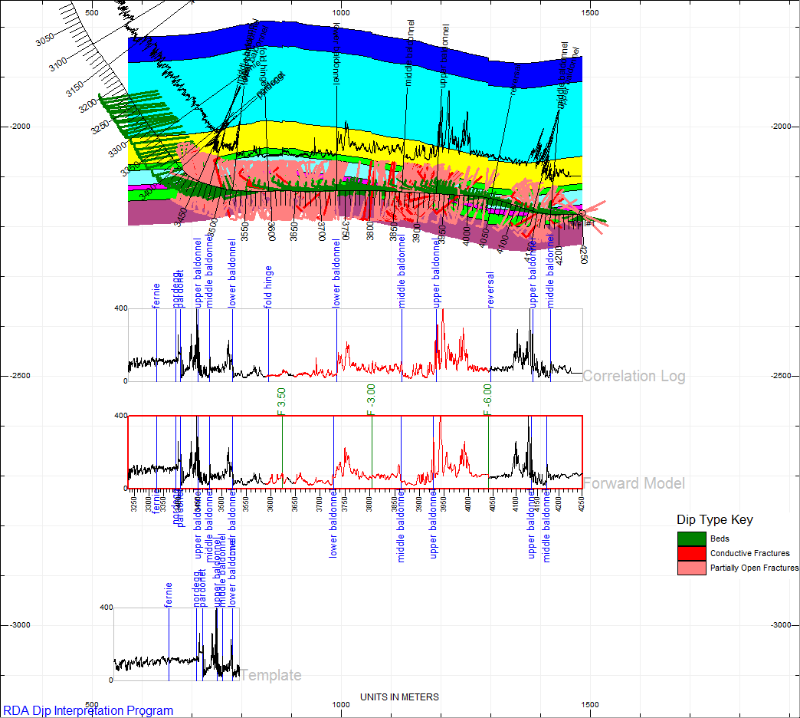
Fault Modeling in a Horizontal Well
Notes:
Only faults are modeled.
Self template.

Slide 23
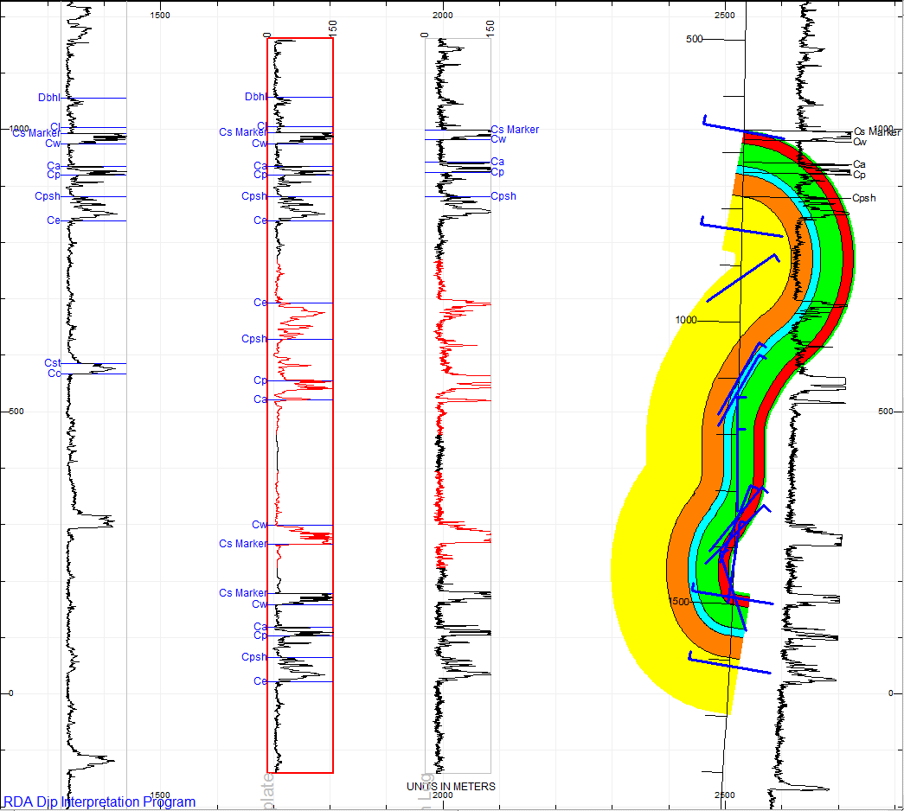
Dip Modeling in a Vertical Well
Template
Forward Model
Log from Well
Notes:
Used only template log, correlation log, and deviation survey. Dips are modeled.
This model can be flipped horizontally and be just as accurate, therefore some geological knowledge of the area would be useful.
There is likely a fault at the lower “syncline”. It is easy to “connect the dots”, so again, prior knowledge is helpful.

Slide 24
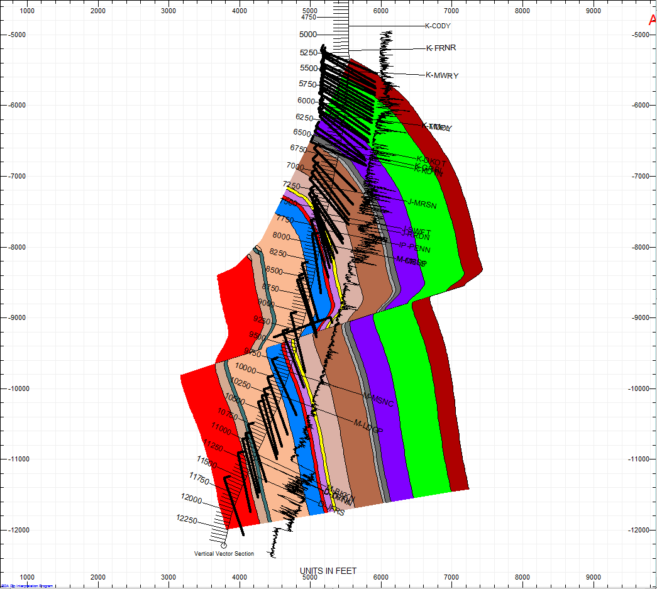
Fault Modeling in a Vertical Well
Notes:
Fault modeling--Used only dip, deviation survey, formation tops, and correlation log.
Structure has been simplified—there are many more faults, one normal fault and one or two more reverse faults.
Faults are simply changes in TST, therefore the faults in a vector section will follow the alignment of the vectors.

Slide 25
Summary
TST can be used to predict log character using a template log
Use of TST provides 3D predictive capabilities
Faults are calculated by adding or subtracting TST
Modeling using TST is applicable to vertical or high-angle wells in addition to horizontal wells
Curtain sections are superior to vertical sections in low dip areas, but in high dip or low borehole deviation, vector sections are better than either curtain or vertical sections
Vector sections use TST for both the direction and length of the vectors
Stratigraphy is a guide, not a primary objective. Choose tops that should provide the most uniform thicknesses.
There may be more than one interpretation possible. Use clues in log character as well as prior knowledge about the area to help with interpretation.

